Slide 1
New Intake Form Preview
Keeping It So Simple

Slide 2
Current State

Slide 3
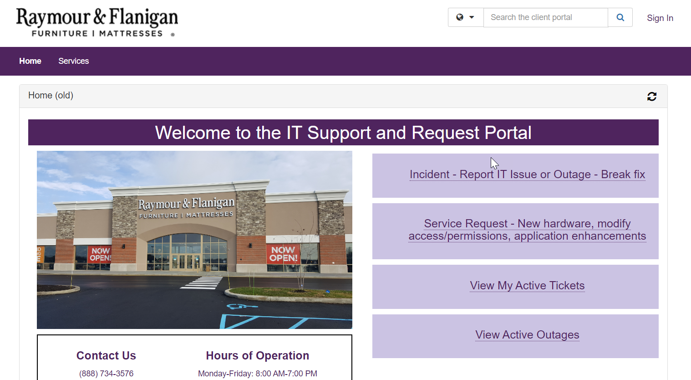


?
?
Or Service Request?
What is a Break fix?
?
Well…it is an Incident to report!
?
?
?
?
?
It’s an issue for ME!
Or Enhancement?
?

